Slide 1
Pillar 2 – Digital Transformation and Digital Skills
Funded by the European Union. Views and opinions expressed are however those of the author(s) only and do not necessarily reflect those of the European Union or the Autónomo Servicio Español para la Internacionalización de la Educación (SEPIE). Neither the European Union nor SEPIE can be held responsible for them.

Slide 2
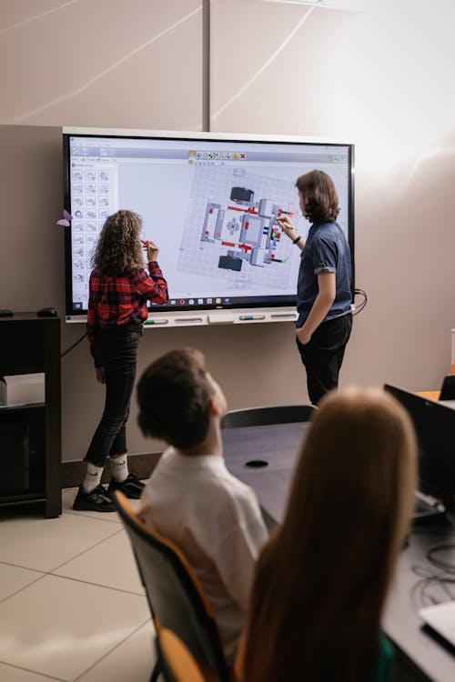
Digital Transformation in VET
From Tools to Institutional Change
How institutions change
How training evolves
How learners are prepared for emerging labour-market needs
Pillar 2 – Digital Transformation and Digital Skills​

Slide 3

Digital Transformation in VET
Your results
What surprised you in your results?
What confirmed your expectations?
Where are your weakest areas?
Pillar 2 – Digital Transformation and Digital Skills​

Slide 4


Digital Transformation in VET
Digital ≠ Transformation
Digital adoption:
Devices
Platforms
Isolated tools
Digital transformation:
Strategy
Curriculum integration
Staff capability
Pedagogy
Monitoring
Pillar 2 – Digital Transformation and Digital Skills​

Slide 5
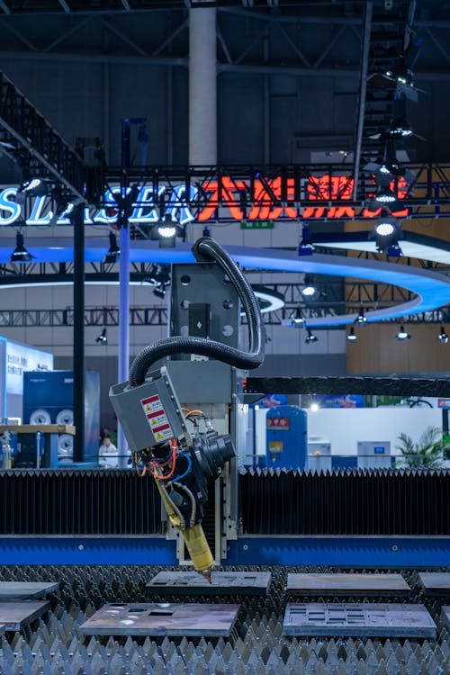
Digital Transformation in VET
Why this matters now
Industry 4.0 is reshaping sectors
AI, data, automation are transforming work
Jobs and tasks are changing
New digital competences are required
Digital transformation in VET is driven by changes in how work is organised and performed
Pillar 2 – Digital Transformation and Digital Skills​

Slide 6
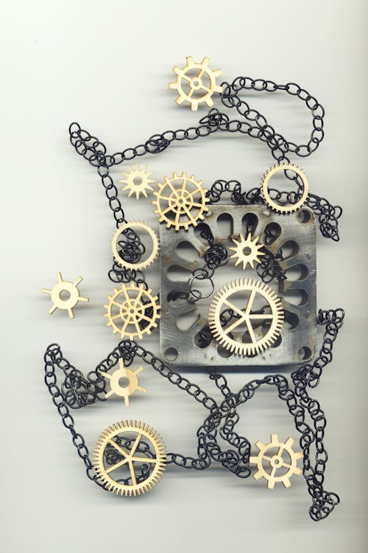
Digital Transformation in VET
VET is more than training
VET centres can act as:
Skills provider
Innovation hubs
Partners for SMEs
Demonstrators of emerging technologies
Regional actor
Which of these roles is currently strongest in your centre?
Pillar 2 – Digital Transformation and Digital Skills​

Slide 7
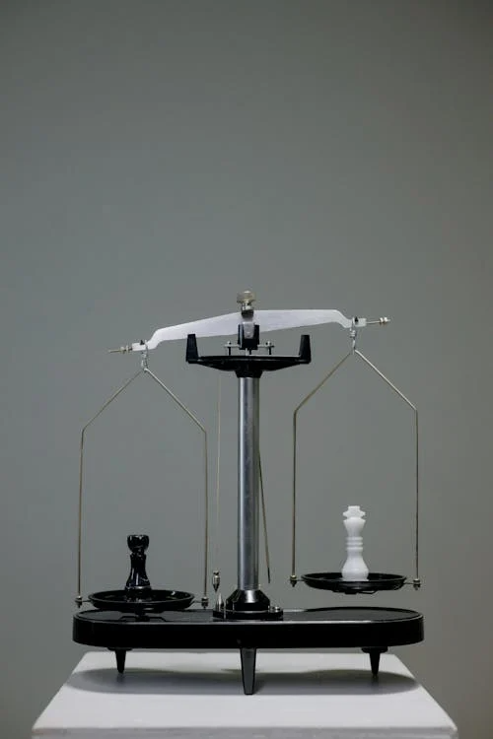
Digital Transformation in VET
Two dimensions of digital transformation
Institutional digital maturity
Strategy
Infrastructure
Organisation
Monitoring
Digital skills development
Curriculum
Pedagogy
Trainer competence
Learner outcomes
Both must evolve together
Pillar 2 – Digital Transformation and Digital Skills​

Slide 8

Digital Transformation in VET
Key Dimensions of Digital Transformation
Institution
Strategy
Infrastructure
Monitoring
Learning
Curriculum
Pedagogy
Trainers
Ecosystem
Industry
Inclusion
Lifelong learning
Pillar 2 – Digital Transformation and Digital Skills​

Slide 9

Digital Transformation in VET
Looking at your results
Which dimension scored lowest?
Which scored highest?
Are results balanced or uneven?
Focus on differences, not averages
Most institutions are not weak — they are uneven
Pillar 2 – Digital Transformation and Digital Skills​

Slide 10
Digital Transformation in VET
What do your results mean?
What is the root cause of your wakest área?
Is it a lack of strategy, skills, or resources?
What happens if this is not addressed?
Is this issue isolated or systemic?
Pillar 2 – Digital Transformation and Digital Skills​

Slide 11





Digital Transformation in VET
Five levels of maturity
TRANSFORMATIONAL
Strategic, monitored, continuously improved
Most institutions are between Emerging and Developing
Integrated across institution
05
Consistent implementation
ADVANCED
04
Some initiatives, uneven
DEVELOPING
03
EMERGING
02
Isolated activities
INITIAL
01
Pillar 2 – Digital Transformation and Digital Skills​

Slide 12


Digital Transformation in VET
Does this sound familiar?
A centre has strong infrastructure but weak teacher digital competence
What happens?
Tools are underused
Learning does not change
Impact is limited
Do you recognise this pattern in your own results?
Pillar 2 – Digital Transformation and Digital Skills​

Slide 13

Digital Transformation in VET
What results often reveal
Tools without pedagogical change
Lack of staff support
IIsolated initiatives
Weak industry alignment
Limited inclusion
No monitoring
Pillar 2 – Digital Transformation and Digital Skills​

Slide 14
Digital Transformation in VET
From results to action
1.
Select ONE priority dimension
2.
Define 2–3 concrete actions
3.
Assign responsibility
4.
Set a timeline
5.
Define how you will measure progress
Do NOT try to improve everything!
Pillar 2 – Digital Transformation and Digital Skills​

Slide 15
Digital Transformation in VET
Using your assessment results
Results highlight strengths and gaps
KPIs show where to focus
Evidence supports decisions
The matrix shows progression
Assess
Interpret
Improve
Monitor
The goal is not scoring higher, but improving impact
Pillar 2 – Digital Transformation and Digital Skills​

Slide 16
Digital Transformation in VET
Key message
Digital transformation happens when strategy, people,and pedagogy move together
Evidence should guide decisions
Start with one priority and build from there
Start small. Build smart
Pillar 2 – Digital Transformation and Digital Skills​

Slide 17

Digital Transformation in VET
Your next step
What is your priority dimension?
What is ONE concrete action?
Who will be responsible?
Be realistic – one action is enough to start
Pillar 2 – Digital Transformation and Digital Skills​

Slide 18
Pillar 2 – Digital Transformation and Digital Skills
Funded by the European Union. Views and opinions expressed are however those of the author(s) only and do not necessarily reflect those of the European Union or the Autónomo Servicio Español para la Internacionalización de la Educación (SEPIE). Neither the European Union nor SEPIE can be held responsible for them.

