Slide 1
PILLAR 4

Slide 2
PILLAR 4
CAPACITY WITHIN AN ORGANISATION - BUILDING RESOURCES,
PEOPLE, RECOGNITION AND INCENTIVES
Regional Economic Development Agency of Šumadija and Pomoravlje Ltd
www.redasp.rs

Slide 3
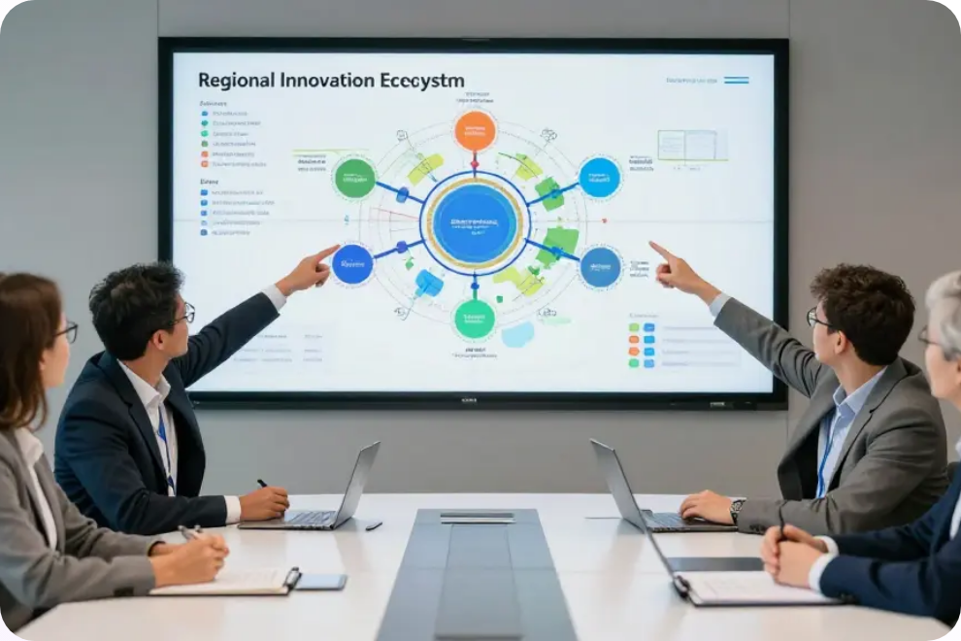
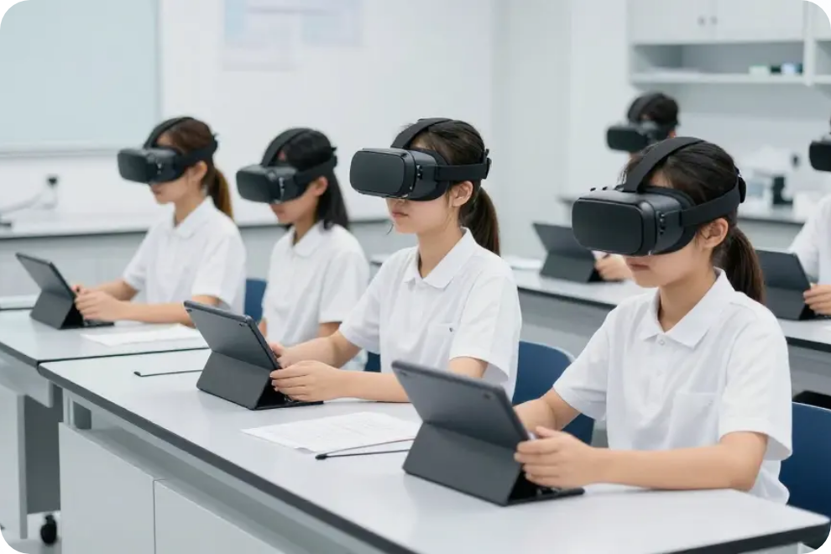
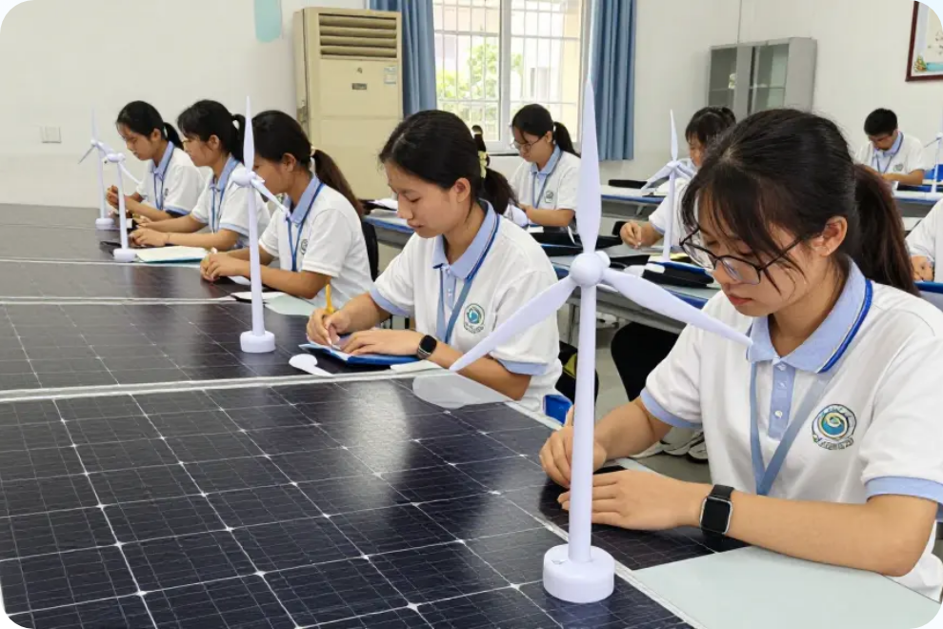
Introduction to VET Transformation
Strategic Evolution | Structured Reflection Utilizing the VETInnovate framework for institutional planning and continuous improvement. | Future Readiness Empowering institutions to lead inclusive, digital, and green skills development across Europe.
Moving beyond traditional roles to become active contributors to regional innovation ecosystems.
PILLAR 4: CAPACITY WITHIN AN ORGANISATION - BUILDING RESOURCES, PEOPLE, RECOGNITION AND INCENTIVES

Slide 4
WHY ORGANIZATIONAL CAPACITY MATTERS
Institutional capacity is the backbone of excellence
Without it: • Strategies remain theoretical • Innovation depends on individuals • Change is not sustainable | With it: • Transformation becomes systemic • Partnerships scale • Impact lasts
PILLAR 4: CAPACITY WITHIN AN ORGANISATION - BUILDING RESOURCES, PEOPLE, RECOGNITION AND INCENTIVES

Slide 5



The Strategic Framework - What Is Organizational Capacity?
The institutional ability to mobilize resources, people, systems and culture to deliver sustainable excellence
Resources Physical and digital infrastructure and technology. | Human Capital Skills, competencies, and workforce development. | Incentives Systems to motivate and retain top talent
PILLAR 4: CAPACITY WITHIN AN ORGANISATION - BUILDING RESOURCES, PEOPLE, RECOGNITION AND INCENTIVES

Slide 6
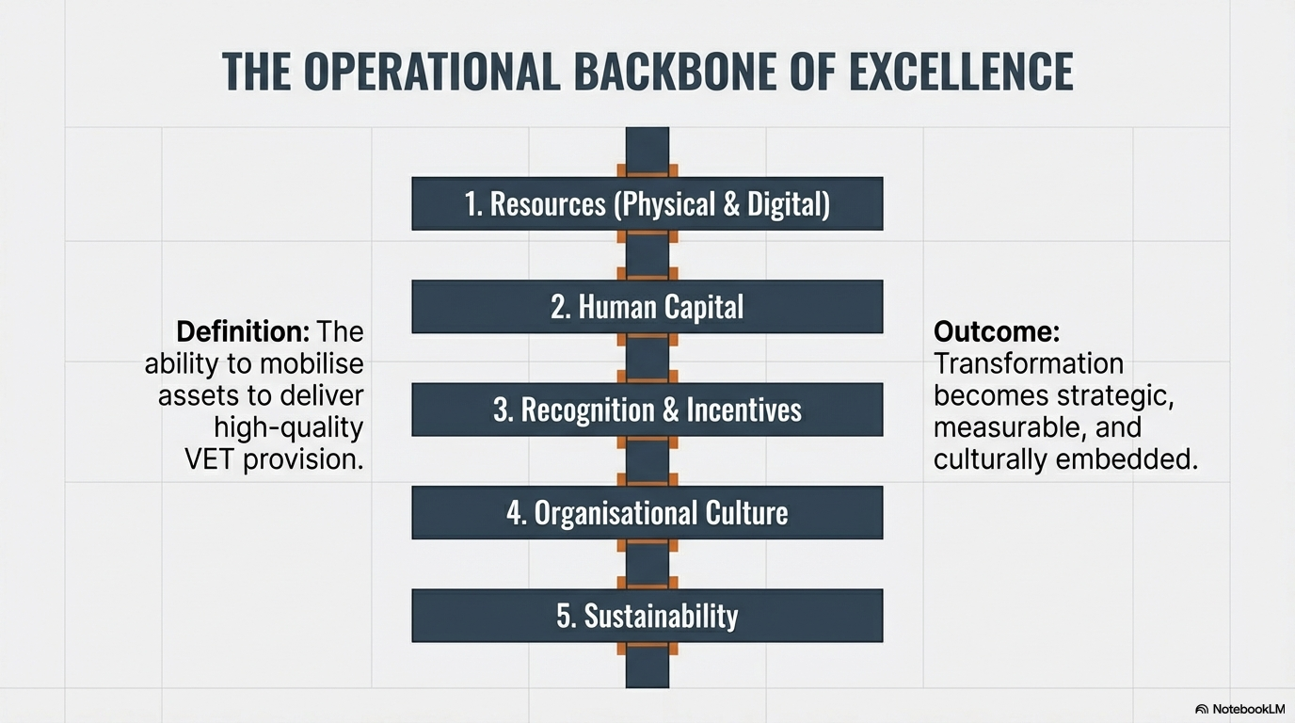
created with the use of
PILLAR 4: CAPACITY WITHIN AN ORGANISATION - BUILDING RESOURCES, PEOPLE, RECOGNITION AND INCENTIVES

Slide 7
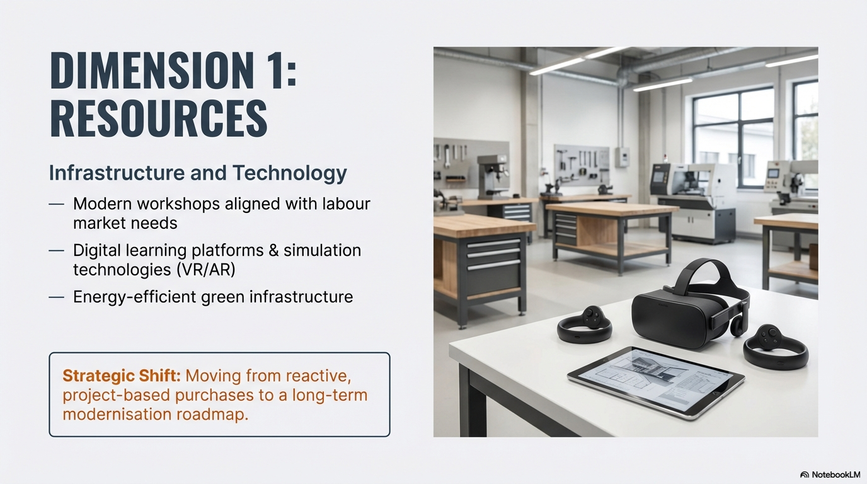
Infrastructure must be planned — not project-dependent.
• Modern workshops
• Digital ecosystems
• VR / AR simulation
• Green facilities
• Strategic renewal planning
created with the use of
PILLAR 4: CAPACITY WITHIN AN ORGANISATION - BUILDING RESOURCES, PEOPLE, RECOGNITION AND INCENTIVES

Slide 8
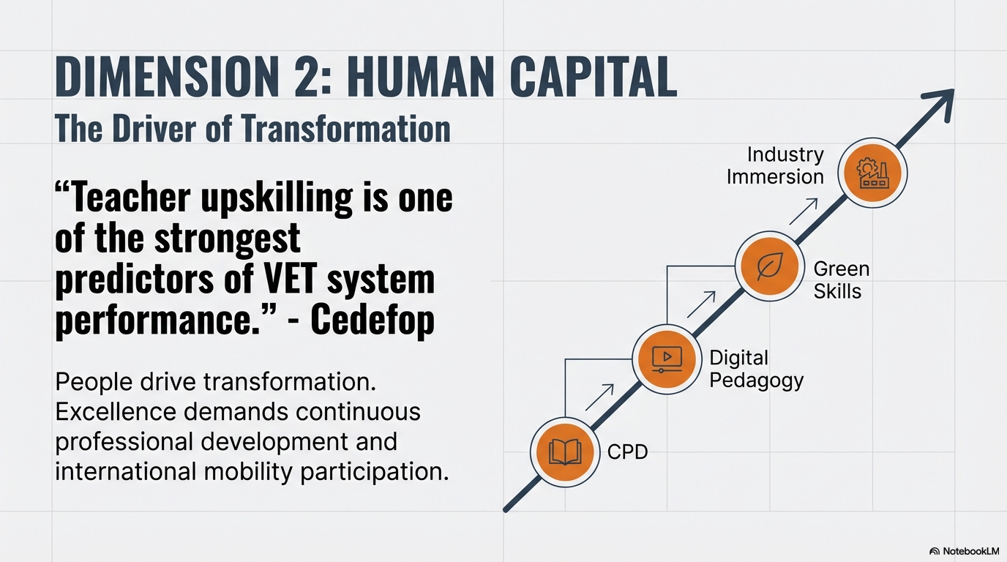
People Drive Transformation
• Continuous Professional Development
• Digital pedagogy
• Green skills integration
• Industry immersion
• International mobility
created with the use of
PILLAR 4: CAPACITY WITHIN AN ORGANISATION - BUILDING RESOURCES, PEOPLE, RECOGNITION AND INCENTIVES

Slide 9
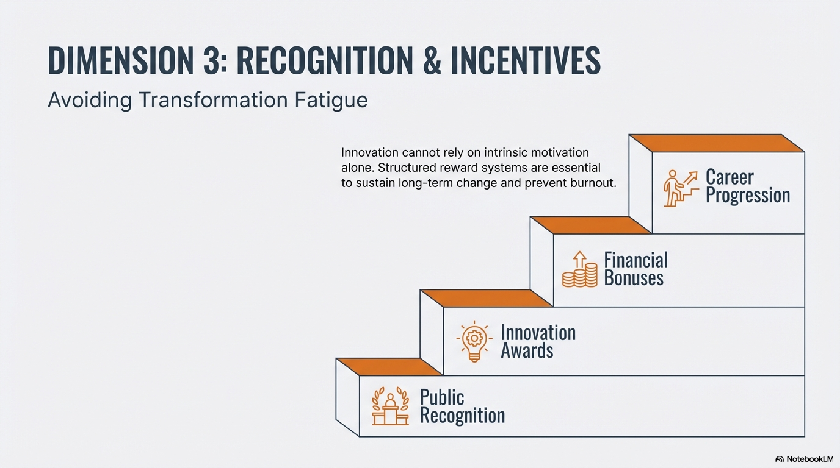
Innovation Must Be Rewarded
• Teaching excellence awards
• Financial incentives
• Career progression pathways
• Project leadership recognition
• Public acknowledgment
created with the use of
PILLAR 4: CAPACITY WITHIN AN ORGANISATION - BUILDING RESOURCES, PEOPLE, RECOGNITION AND INCENTIVES

Slide 10
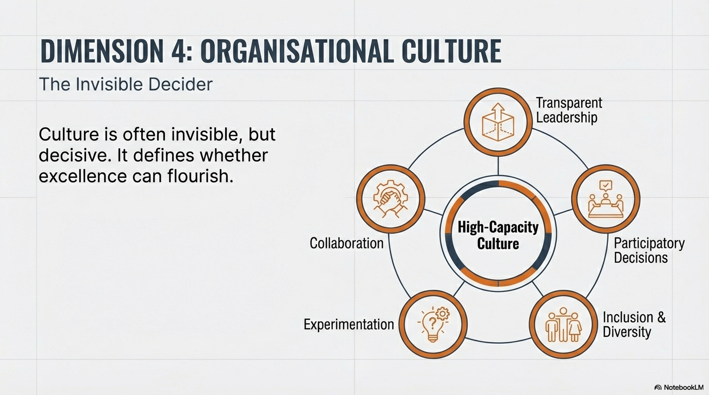
Culture Determines Whether Strategy Lives
✔ Transparent leadership
✔ Participatory governance
✔ Cross-department collaboration
✔ Inclusion & diversity
✔ Learning from failure
created with the use of
PILLAR 4: CAPACITY WITHIN AN ORGANISATION - BUILDING RESOURCES, PEOPLE, RECOGNITION AND INCENTIVES

Slide 11
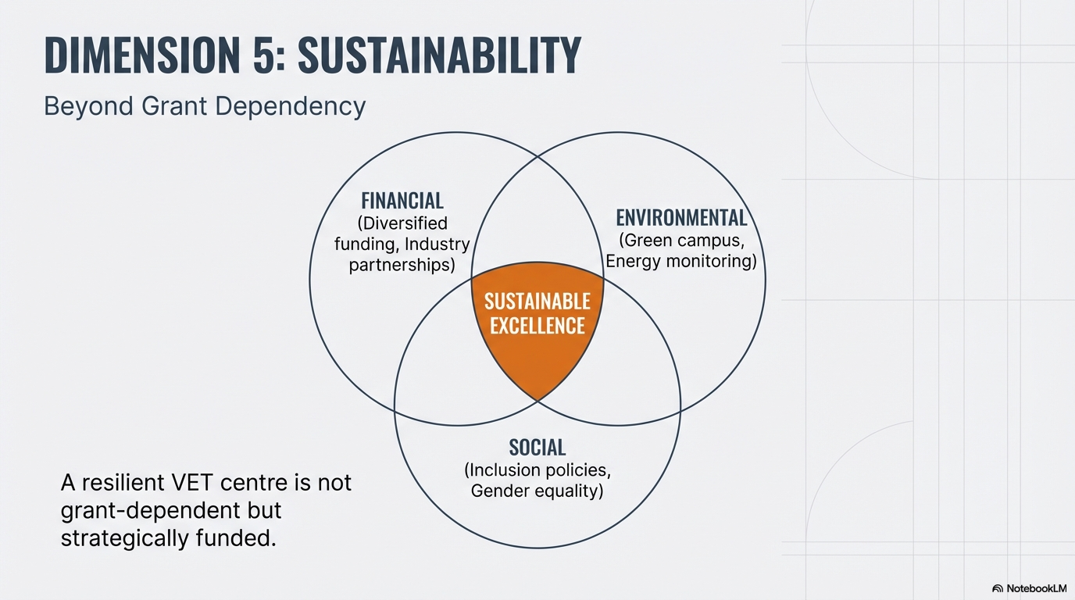
Resilience Requires Stability
created with the use of
PILLAR 4: CAPACITY WITHIN AN ORGANISATION - BUILDING RESOURCES, PEOPLE, RECOGNITION AND INCENTIVES

Slide 12
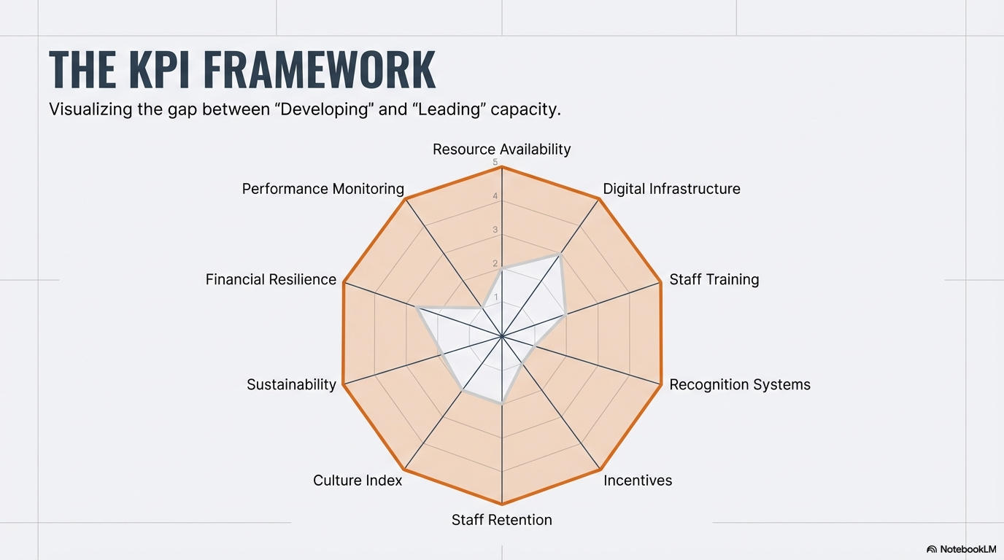
Measuring Institutional Capacity
10 Key Performance Indicators
created with the use of
PILLAR 4: CAPACITY WITHIN AN ORGANISATION - BUILDING RESOURCES, PEOPLE, RECOGNITION AND INCENTIVES

Slide 13
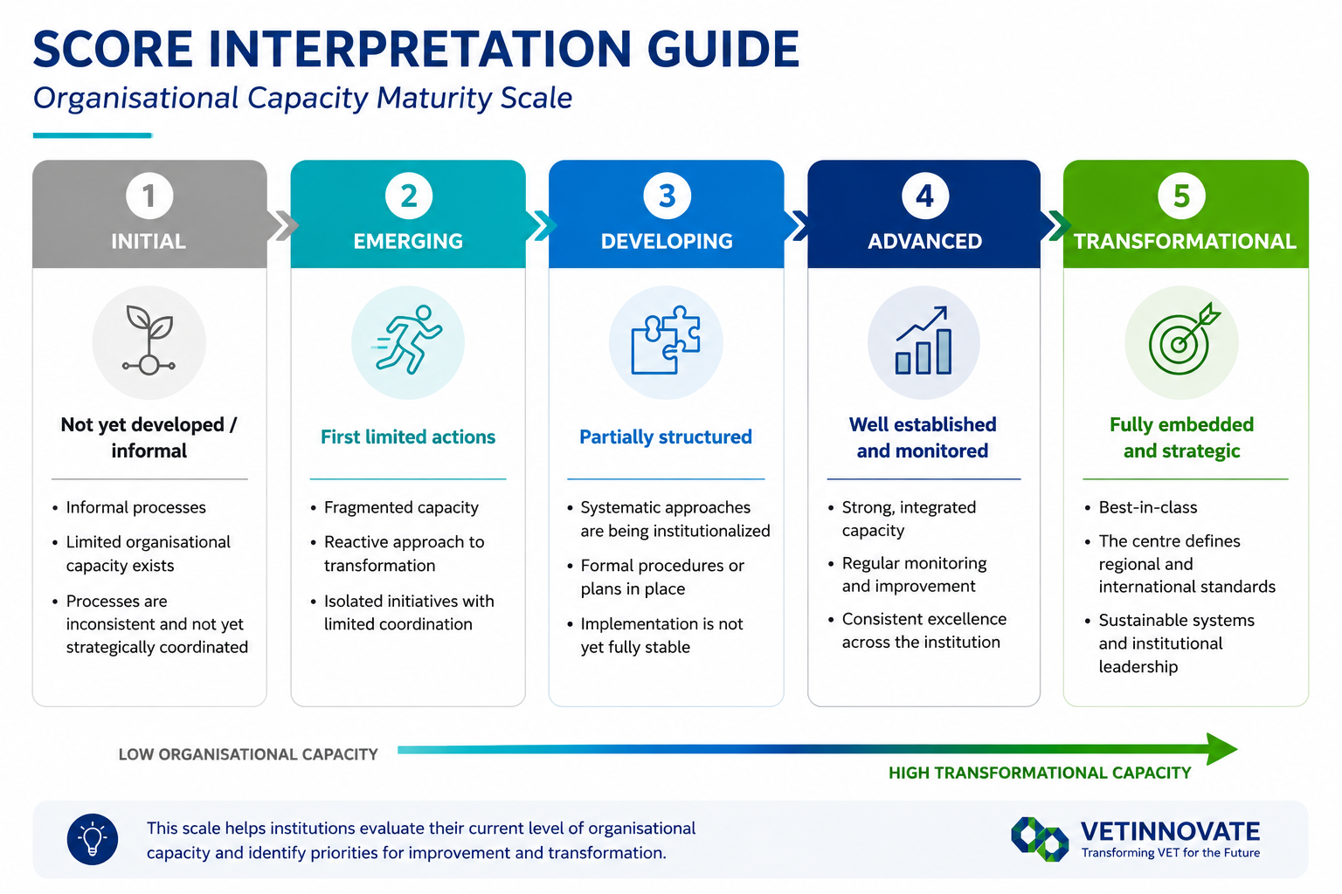
PILLAR 4: CAPACITY WITHIN AN ORGANISATION - BUILDING RESOURCES, PEOPLE, RECOGNITION AND INCENTIVES

Slide 14

Practical Implementation
How to Use the Tool
Internal assessment team
Individual scoring
Consensus workshop
Priority identification
Action plan
Annual reassessment
From Data to Strategy
Dimension averages
Radar chart
Gap identification
Strategic prioritization
PILLAR 4: CAPACITY WITHIN AN ORGANISATION - BUILDING RESOURCES, PEOPLE, RECOGNITION AND INCENTIVES

Slide 15
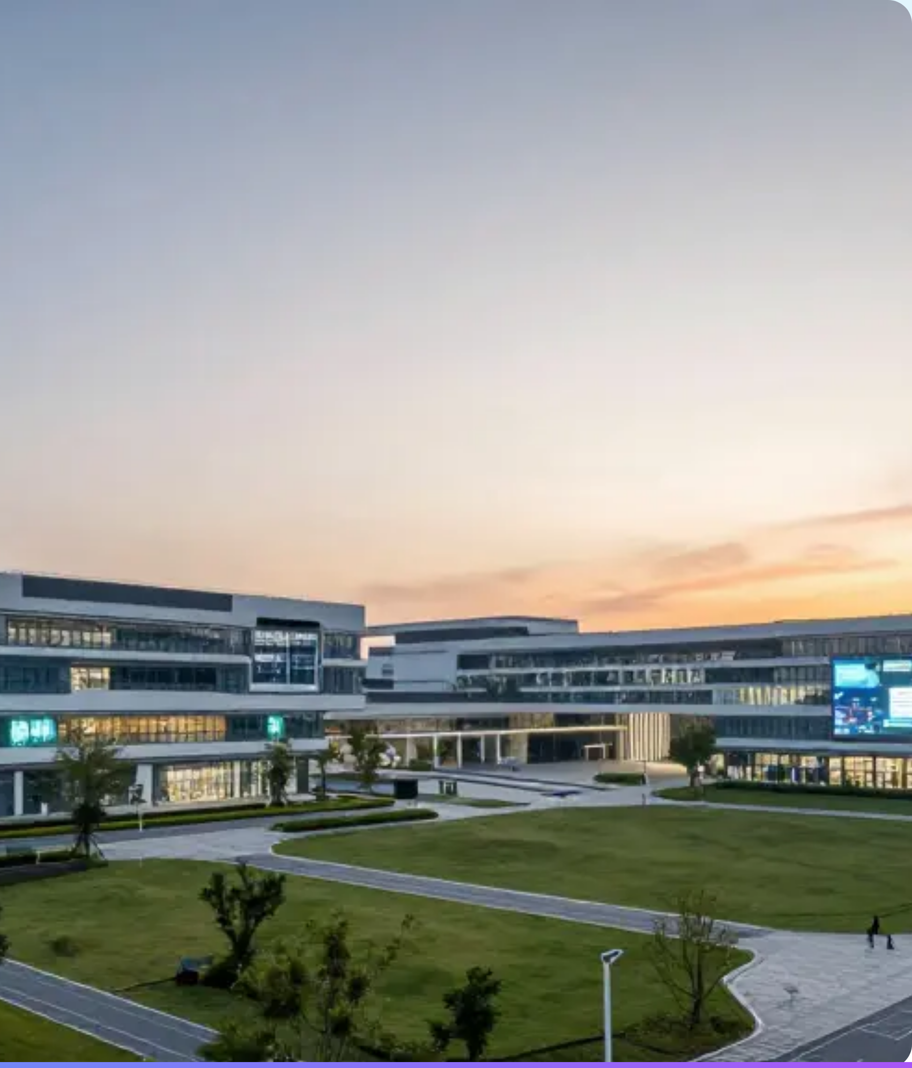
Conclusions & Next Steps
The Path Forward
Transformation requires moving from reactive
projects to proactive modernization roadmaps:
  Mandatory industry placements for staff
  Diversified funding strategies
  Continuous KPI monitoring
PILLAR 4: CAPACITY WITHIN AN ORGANISATION - BUILDING RESOURCES, PEOPLE, RECOGNITION AND INCENTIVES

Slide 16
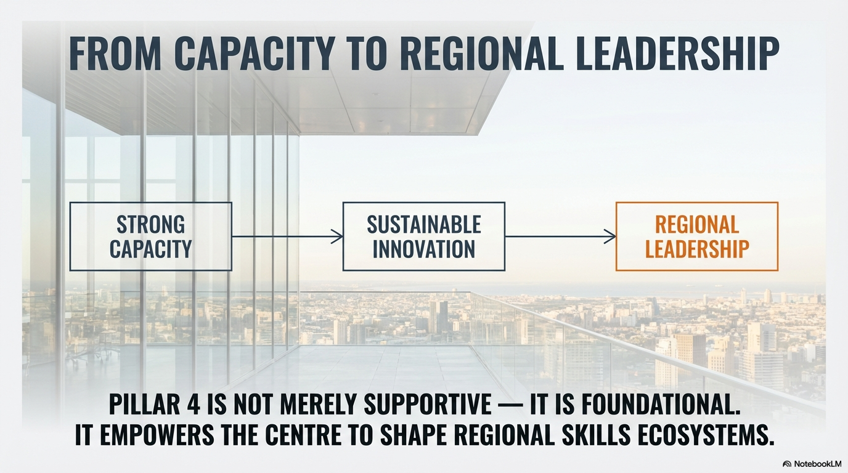
created with the use of
Pillar 4

