Slide 1
Pillar 5: Ecosystems and VET networks
Funded by the European Union. Views and opinions expressed are however those of the author(s) only and do not necessarily reflect those of the European Union or the Autónomo Servicio Español para la Internacionalización de la Educación (SEPIE). Neither the European Union nor SEPIE can be held responsible for them.

Slide 2
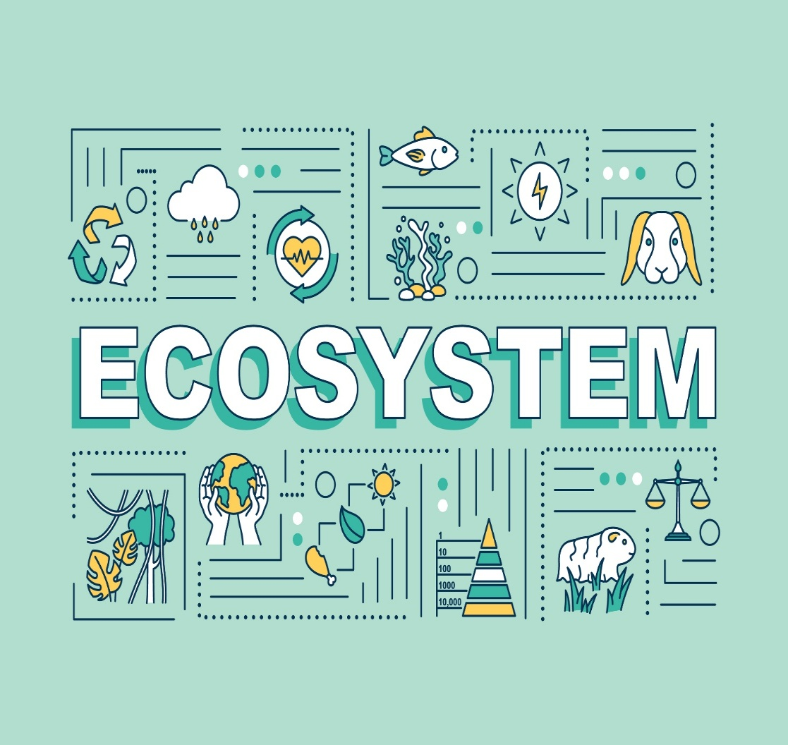
Elements of the VET Ecosystem
Active collaboration network
A VET ecosystem involves educational institutions, companies, public administrations, and social agents working together.
Complementary roles
VET centers provide training, companies provide the work environment, and administrations provide regulation and funding.
Applied learning for students
Students learn through real experiences, practical projects, and direct contact with company professionals.
Connection with the labor market
The ecosystem prepares students to successfully integrate into today’s workforce.

Slide 3
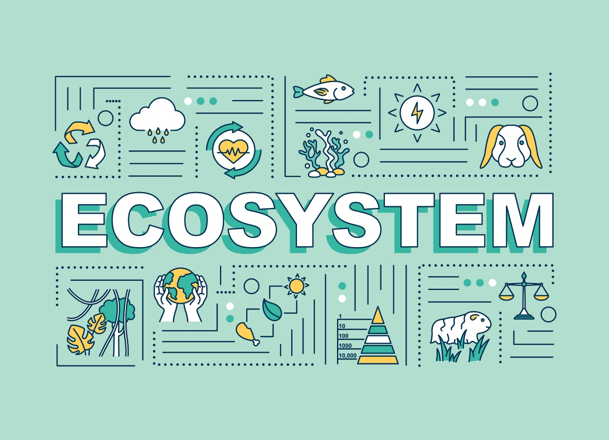
Elements of the VET Ecosystem
Vocational Training Centers
VET centers provide basic knowledge, technical skills, and educational guidance to students.
Company Participation
Companies offer practical training, updated technology, and real project experience.
Role of Public Administrations
Public administrations regulate, fund, and ensure the quality and equity of vocational training.
Teachers, Universities, and Innovation
Teachers and universities drive innovation and ensure alignment with professional reality.

Slide 4

DUAL VET: learning by doing
Combined learning
Dual VET integrates classroom theory with practical experience in real companies, enabling effective learning.
Skills development
Students gain both technical and transversal skills such as responsibility and teamwork.
Mutual benefits
Dual VET improves employability and helps companies train professionals adapted to their needs.

Slide 5
DUAL VET: learning by doing
Practice-based learning
Combines theory and real practice for deeper and long-lasting understanding.
Early work experience
Students gain work experience and develop a professional attitude early on.
Improved employability
Increases employment opportunities and facilitates job contracts after graduation.
Development of transversal skills
Enhances teamwork, communication, and problem-solving skills.

Slide 6

Public-Private Partnerships (PPP)
Link between education and work
PPPs connect training centers, companies, and public administrations to align education with labor market needs.
Integration of modern technologies
VET centers incorporate current business technologies and methods.
Benefits for teachers and students
PPPs keep teachers updated and ensure students develop relevant, in-demand skills.

Slide 7

Benefits of Public-Private Partnerships for students
High-quality professional internships
Students access real work environments, applying knowledge and gaining experience.
Dual VET programs
Combine learning in schools and companies through real projects.
Access to advanced technology
Companies provide machinery and tools to enhance practical training.
Professional preparation and employment
These experiences build confidence and create job opportunities.

Slide 8
How Public-Private Partnerships are created?
Identification of companies
Relevant companies are selected to provide internships and resources.
Definition of contributions
Both sides define inputs such as facilities, mentors, technology, and teaching staff.
Planning and monitoring
A joint training plan is designed, mentors are assigned, and student progress is monitored.
Evaluation
A final assessment formally recognizes the learning achieved

Slide 9

Regional VET ecosystems
Multisector collaboration
Companies, training centers, and public administrations work together to boost regional development.
Adaptation to strategic sectors
Training programs adjust to local labor market demands.
Boost to competitiveness
Alignment with the labor market improves competitiveness and creates sustainable jobs.

Slide 10
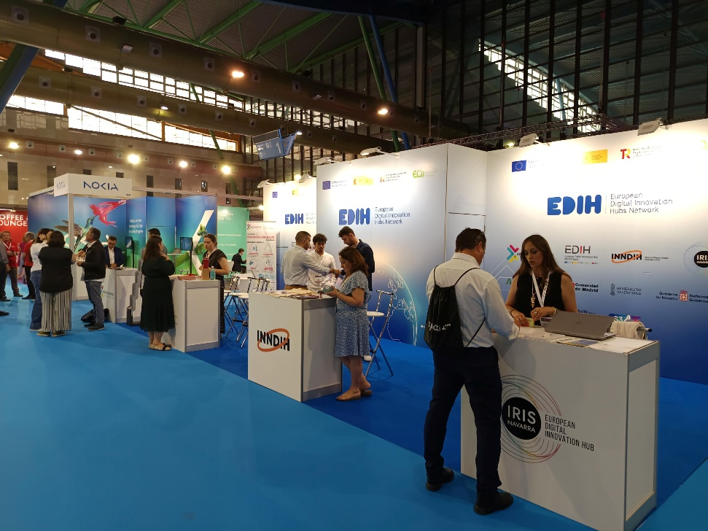
Knowledge exchange
Collaboration with companies and institutions
Learning is enriched through partnerships that connect training with the labor market.
Practical and professional activities
Workshops, technical visits, and fairs bring students closer to real work environments.
Development of skills and networks
Practical learning builds transversal skills and professional networks.

Slide 11

European Training Networks
Expansion of the VET ecosystem
European networks extend training beyond national borders and promote international cooperation.
Development of skills
International experience improves language skills, autonomy, and adaptability.
Increased employability
Participation opens new job opportunities and strengthens VET in the global market.

