Slide 1
Pillar 6: Supporting and preparing VET learners for the digital & entrepreneurial skills transition
Funded by the European Union. Views and opinions expressed are however those of the author(s) only and do not necessarily reflect those of the European Union or the Autónomo Servicio Español para la Internacionalización de la Educación (SEPIE). Neither the European Union nor SEPIE can be held responsible for them.

Slide 2
Objective and scope of this module
Preparing for Digital Transition
The module equips students with skills and mindset to navigate technological and economic changes successfully.
Educational Transformation
Active learning methods and real-world problem solving replace traditional teaching to connect education with industry needs.
Digital Skills and Sustainability
Combining advanced digital skills with sustainability awareness to create social and environmental value.
Alignment with European Policies
The module supports European digitalization, green transition, and innovation frameworks to enhance employability.

Slide 3
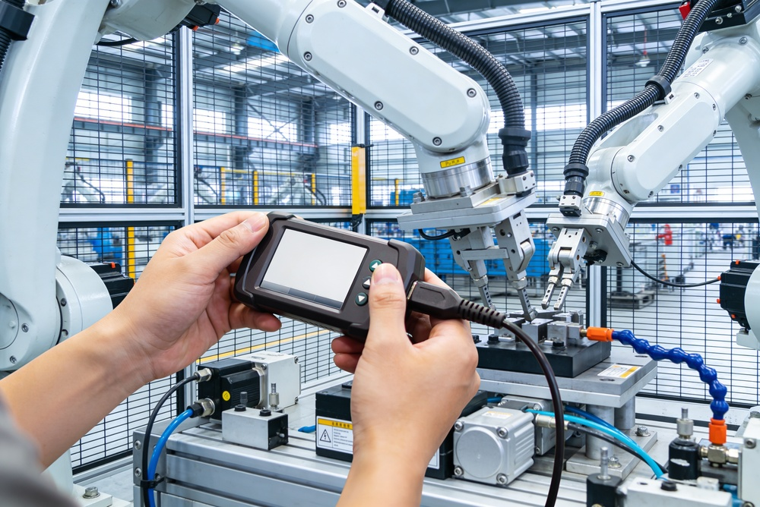
Current Labor Market Context
Technological Transformation
Automation and AI are reshaping job roles and workflows across all economic sectors.
Evolving Labor Competencies
Digital literacy, analytical thinking, and adaptability are essential skills for modern workers.
Continuous Learning Requirement
Ongoing upskilling and flexibility enable workers to remain employable in a changing market.
Role of Vocational Education
VET bridges education and employment through practice-oriented, industry-aligned training.
  .

Slide 4
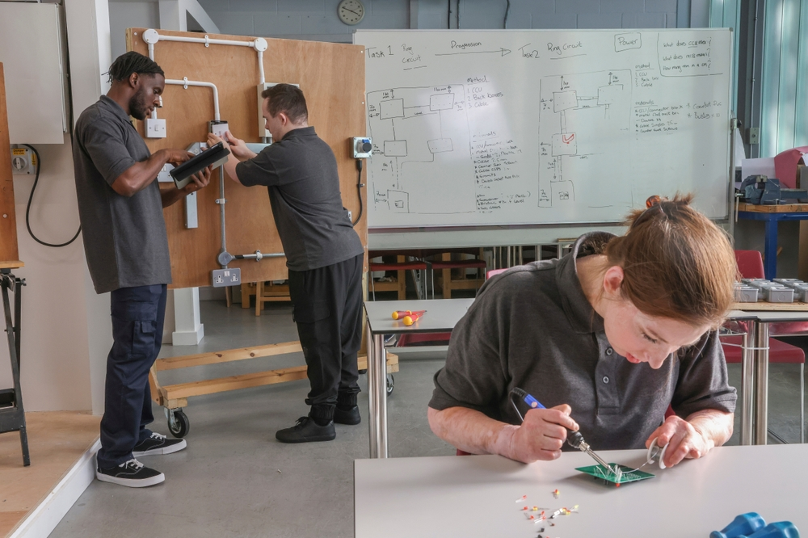
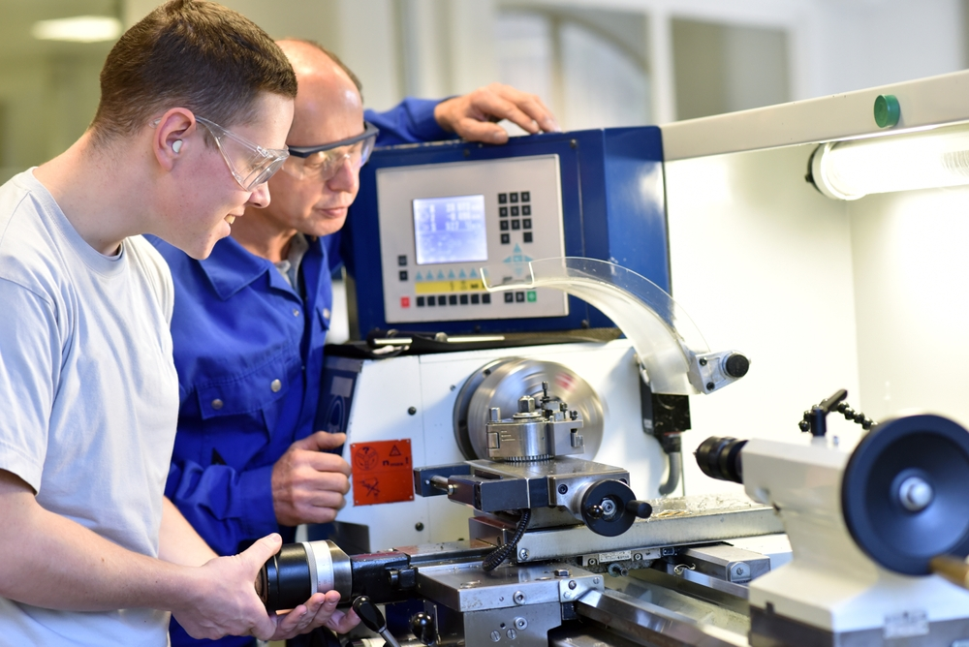
Strategic Role of VET
Industry Connection
  VET maintains strong links with productive sectors to ensure curricula meet current industry needs.
Hands-On Learning
  VET emphasizes practical skills through project-based learning and work-based training methods.
Future-Oriented Training
  VET anticipates labor market trends to improve employability and workforce resilience.
Innovative and Inclusive Vision
  VET supports digital transformation, entrepreneurship, sustainability and drives social inclusion.

Slide 5

Productive sectors requiring digitalization
All productive sectors must implement digitalization initiatives across all areas to enhance competitiveness and profitability.
Industry 4.0 Transformation: Robotics, sensors, and data analytics enhance efficiency and decision-making in modern industrial production.
Digital Healthcare Innovation: Digital tools improve patient care, diagnosis, and monitoring while optimizing healthcare resources.
Smart Agriculture Practices: Sensors and data analysis reduce crop loss, optimize resource use, and monitor environmental conditions.
Digital Public Administration: Digital government initiatives streamline processes, reduce wait times, and improve citizen services

Slide 6

Entrepreneurship after VET
Entrepreneurship as Transversal Competence: Entrepreneurship in VET is about innovation, leadership, and value creation across various employment scenarios.
Active Learning and Collaboration: VET entrepreneurship education emphasizes real-world projects, active learning methods, and partnerships with companies.
Importance of Digital Competencies: Digital skills like data analysis, IoT, and cybersecurity enable innovation and support digital transformation in industries.
Preparing for Sustainable Opportunities :Integrating entrepreneurship and digital skills prepares learners for organizational growth and sustainable professional futures.

Slide 7

Demand for new competencies
Essential Digital Competencies
Data analysis, IoT, and cybersecurity are critical skills across all professional fields today.
Automation and Robotics Skills
Programming, system integration, and maintenance skills are vital in industry and healthcare sectors.
AI Integration and Ethics
Understanding AI applications, limitations, and ethics is key in production and customer service.
Complementing Traditional Skills
Digital capabilities expand but do not replace traditional technical expertise and craftsmanship.

Slide 8

Soft skills and employability
Importance of Soft Skills
Soft skills complement technical knowledge and are vital for effective real-world application and employability.
Key Soft Skills
Communication, adaptability, resilience, critical thinking, and emotional management are highly demanded in today's labor market.
Pedagogical Integration
Active methodologies like collaborative projects and simulations help students develop and internalize soft skills effectively.
Holistic Employability Approach
Embedding soft skills across curricula produces professionals who contribute effectively to organizational culture and success.

Slide 9

Career guidance and employability
Role of Career Guidance
Career guidance helps students identify interests, values, and strengths for informed academic and career decisions.
Understanding Labor Market
Guidance services inform learners about labor market opportunities, training pathways, and career progression.
Employability Skills
Employability depends on technical, soft skills, and personal competencies essential for career success.
Smooth Transition to Employment
Strong guidance systems reduce early school leaving and support smoother transitions to employment or self-employment.

Slide 10

Sustainable and digital integration
Digital and Ecological Transformation
Modern VET integrates digital innovation with ecological goals to address sustainability challenges effectively.
Practical Sustainable Applications
Renewable energy with IoT, smart agriculture, healthcare, and sustainable mobility showcase technology supporting environment.
Educational Frameworks Supporting Sustainability
Frameworks like GreenComp foster environmental competencies and systemic thinking for sustainable tech solutions.
Preparing Future Professionals
VET equips students to lead responsible innovation by combining digital and green skills for future challenges.
.

Slide 11

Entrepreneurial Training
Entrepreneurial competencies:
Creativity
Vision
Motivation
Planning
Decision-making
Team management
Application in VET
Design of activities and projects to promote entrepreneurial thinking in VET

Slide 12

Career Guidance and Employability
Career guidance helps students identify interests and values for academic and career decision-making.
Employability is the ability to obtain and progress in employment through technical skills and soft skills.
A strong guidance system reduces early school leaving and facilitates the transition to employment or self-employment..

Slide 13

Environmental Competencies
  GreenComp is a European framework that promotes competencies to address environmental challenges responsibly.
  It promotes systemic thinking and the design of integrated sustainable solutions in technological projects.
  It incorporates green competencies into training to strengthen environmental awareness and emerging sectors.

Slide 14
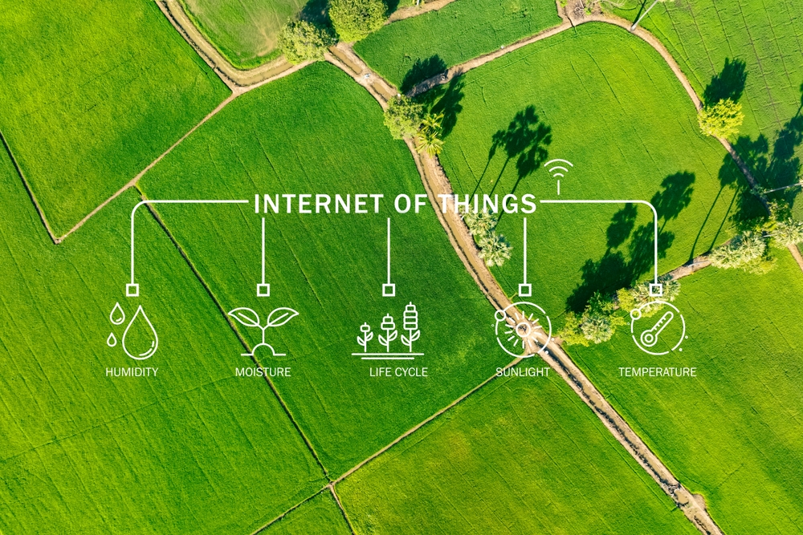
Sustainable and Digital Integration
Digital and ecological transformation
Digital and environmental integration jointly addresses technological innovation and sustainability across all sectors.
Practical sustainable applications
Examples include the use of renewable energy through IoT sensors, smart agriculture and healthcare, and digitally enabled sustainable mobility.
New professions and training
VET prepares students to implement responsible and efficient solutions in real-world practice.

Slide 15

Key Evaluation Indicators (KPI)
Skill development and guidance
Assessment of entrepreneurial learning opportunities, soft skill development, and career guidance services
Innovation and international mobility
Analysis of interdisciplinary sustainable innovation and international student mobility to enrich training.
Impact and student satisfaction
Evaluation of alumni entrepreneurial activity and student satisfaction levels to implement improvements in training processes.

Slide 16
Conclusion
Need for digital transition
Digital and entrepreneurial transformation is essential for VET in today’s constantly changing labor market.
Competencies and entrepreneurship
Strengthening digital skills and fostering entrepreneurship prepares students to become hybrid professionals with high employability.
Preparation for future challenges
Training innovative professionals capable of leading change and responding to current economic, social, and environmental challenges.

