Slide 1
PILLAR 8: BUILDING GREEN SKILLS IN THE FIELD OF MANUFACTURING, AUTOMOTIVE, ROBOTICS AND ENERGY

Slide 2

Main objectives of Pillar:
integrate green competences into VET curricula across technical disciplines;
align vocational training with the requirements of the green and digital transition;
promote environmental awareness and sustainable practices among learners and educators;
strengthen cooperation between VET providers and industry stakeholders to ensure labour market relevance.

Slide 3
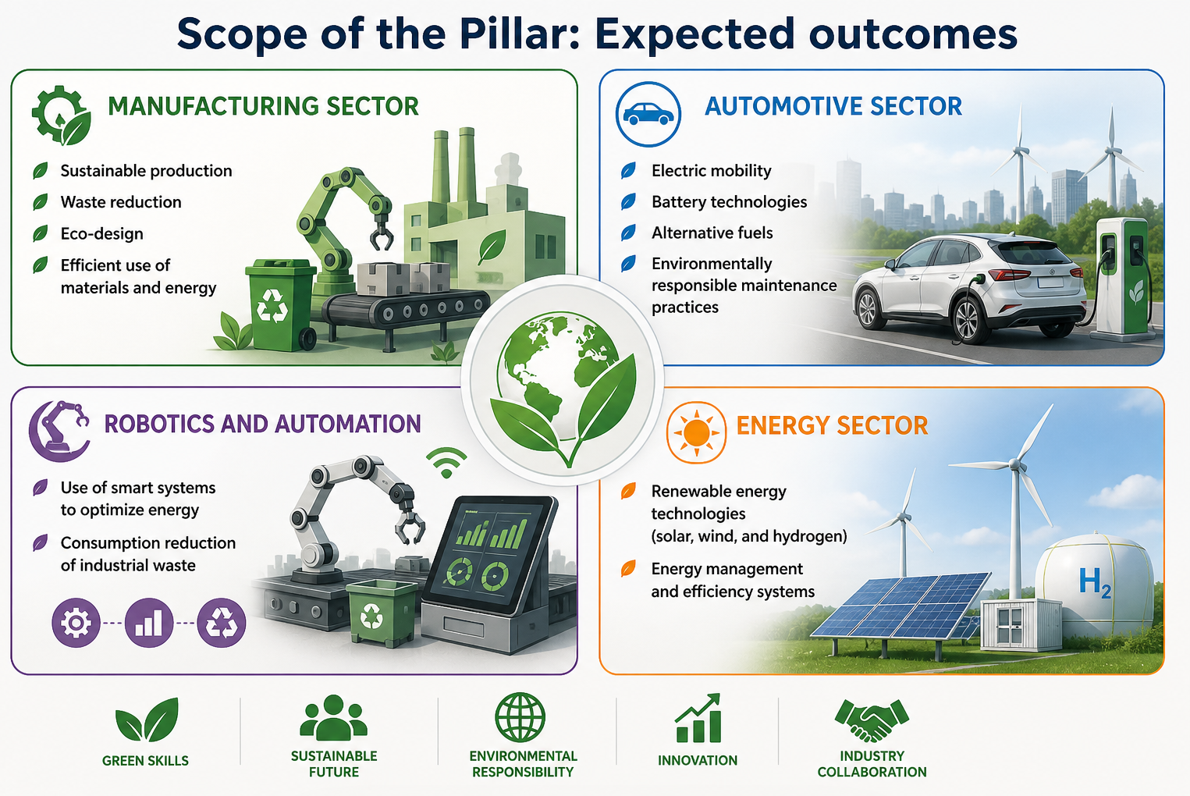
Presentation Pillar 8

Slide 4
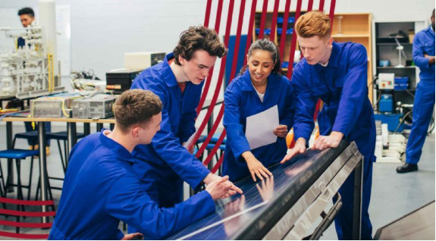
Why Green Skills Matters in VET
Vocational education and training (VET) centers play a vital role in developing this workforce as we transition to a climate-neutral economy.
The European Green Deal and related policies call for significant reductions in emissions, improved energy efficiency, and the responsible use of resources.
These changes cannot be achieved without a workforce that understands and applies the principles of sustainability in their day-to-day technical work.
Presentation Pillar 8

Slide 5
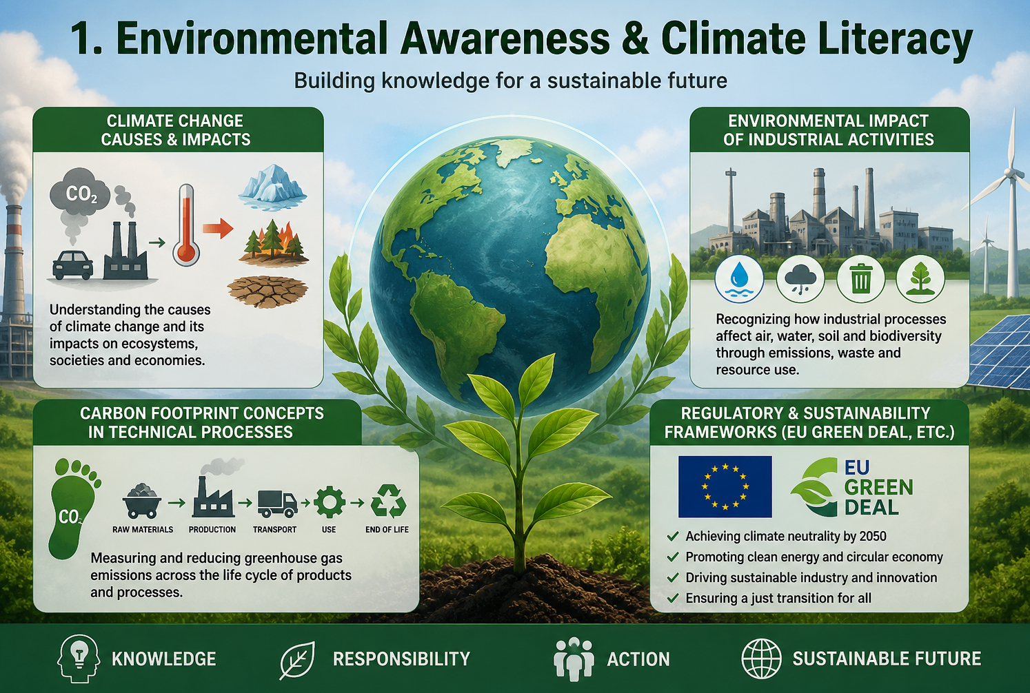
Key Dimensions of Building Green Skills for VET centres
Presentation Pillar 8

Slide 6
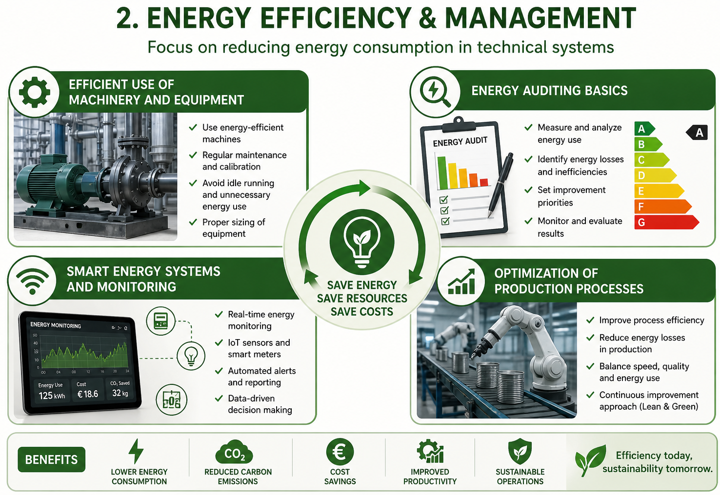
Key Dimensions of Building Green Skills for VET centres
Presentation Pillar 8

Slide 7
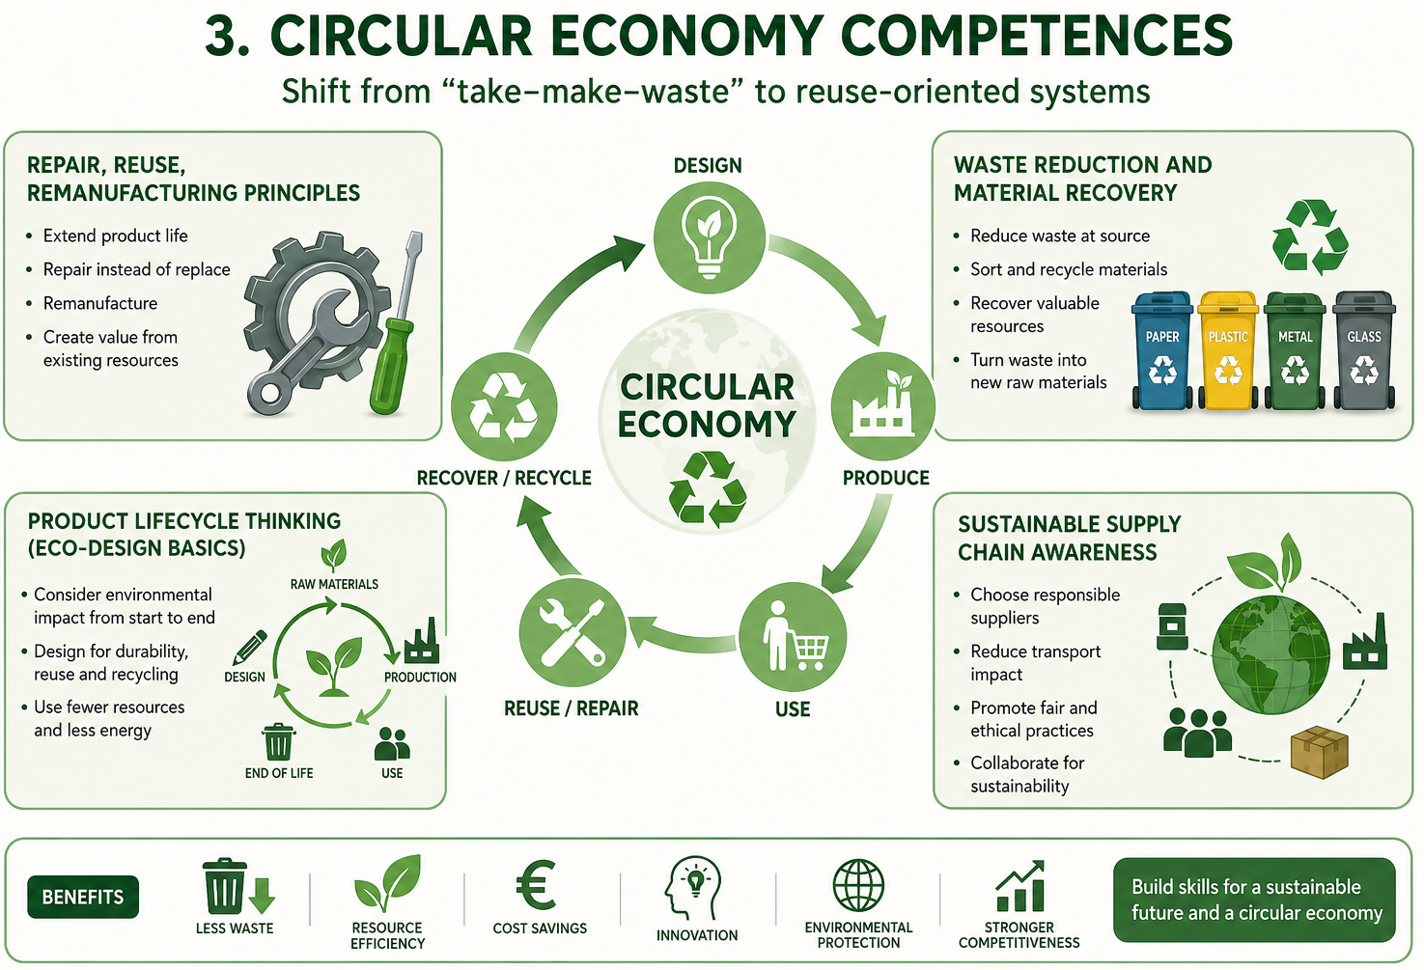
Key Dimensions of Building Green Skills for VET centres
Presentation Pillar 8

Slide 8
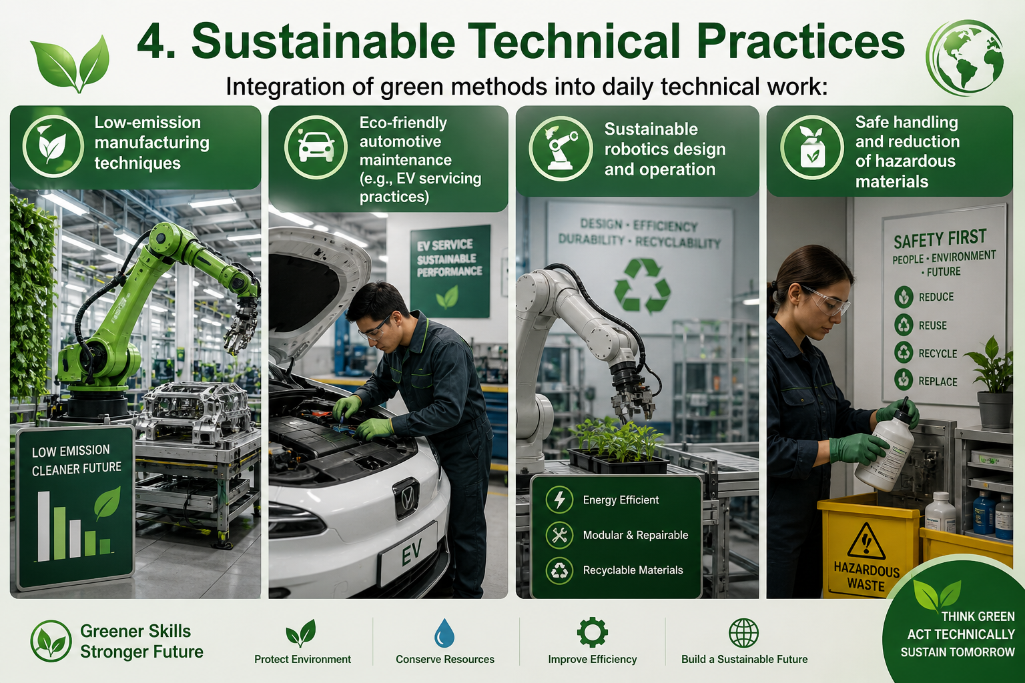
Key Dimensions of Building Green Skills for VET centres
Presentation Pillar 8

Slide 9
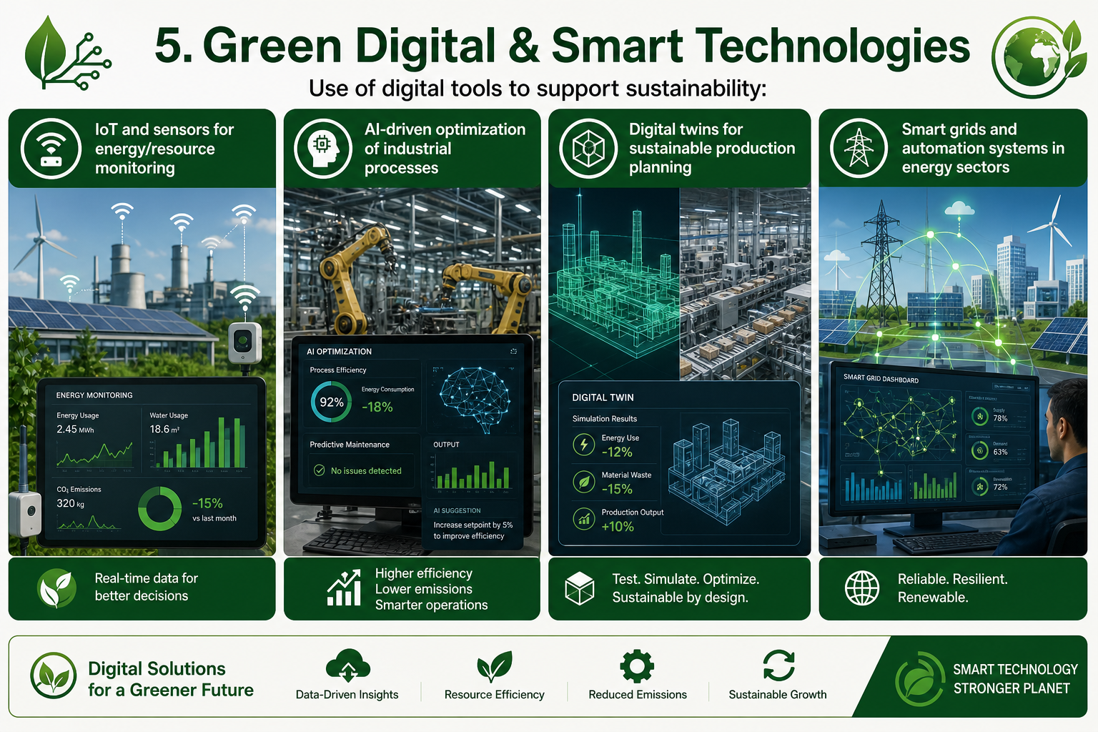
Key Dimensions of Building Green Skills for VET centres
Presentation Pillar 8

Slide 10
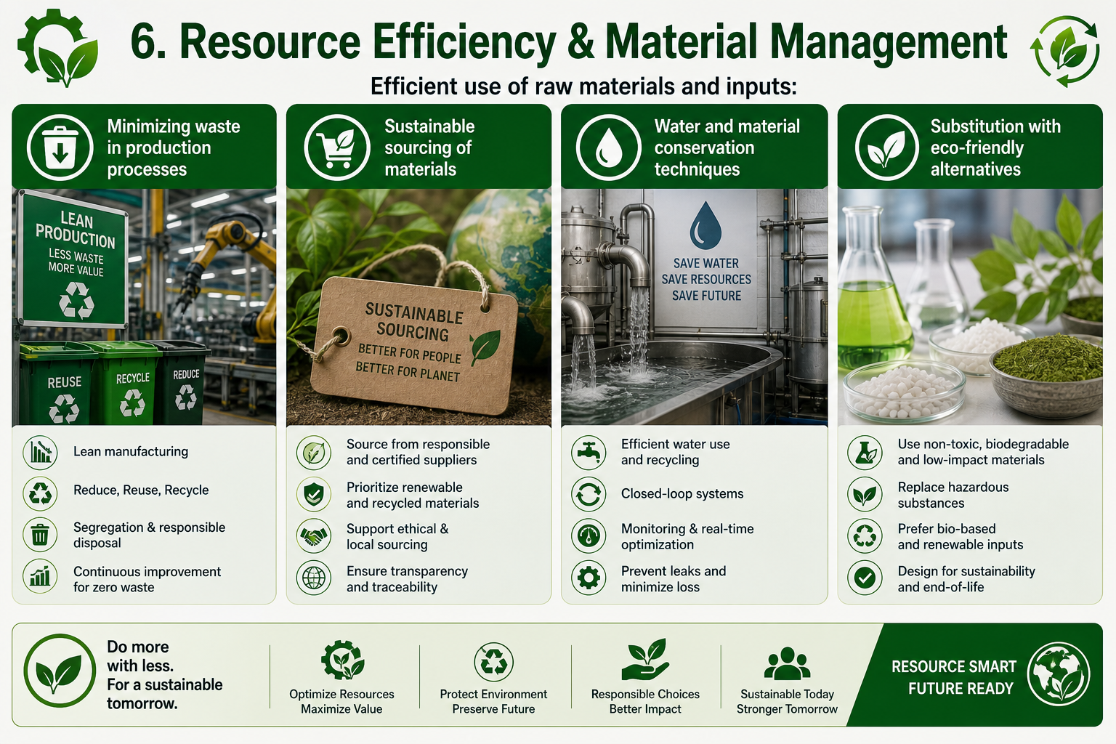
Key Dimensions of Building Green Skills for VET centres
Presentation Pillar 8

Slide 11
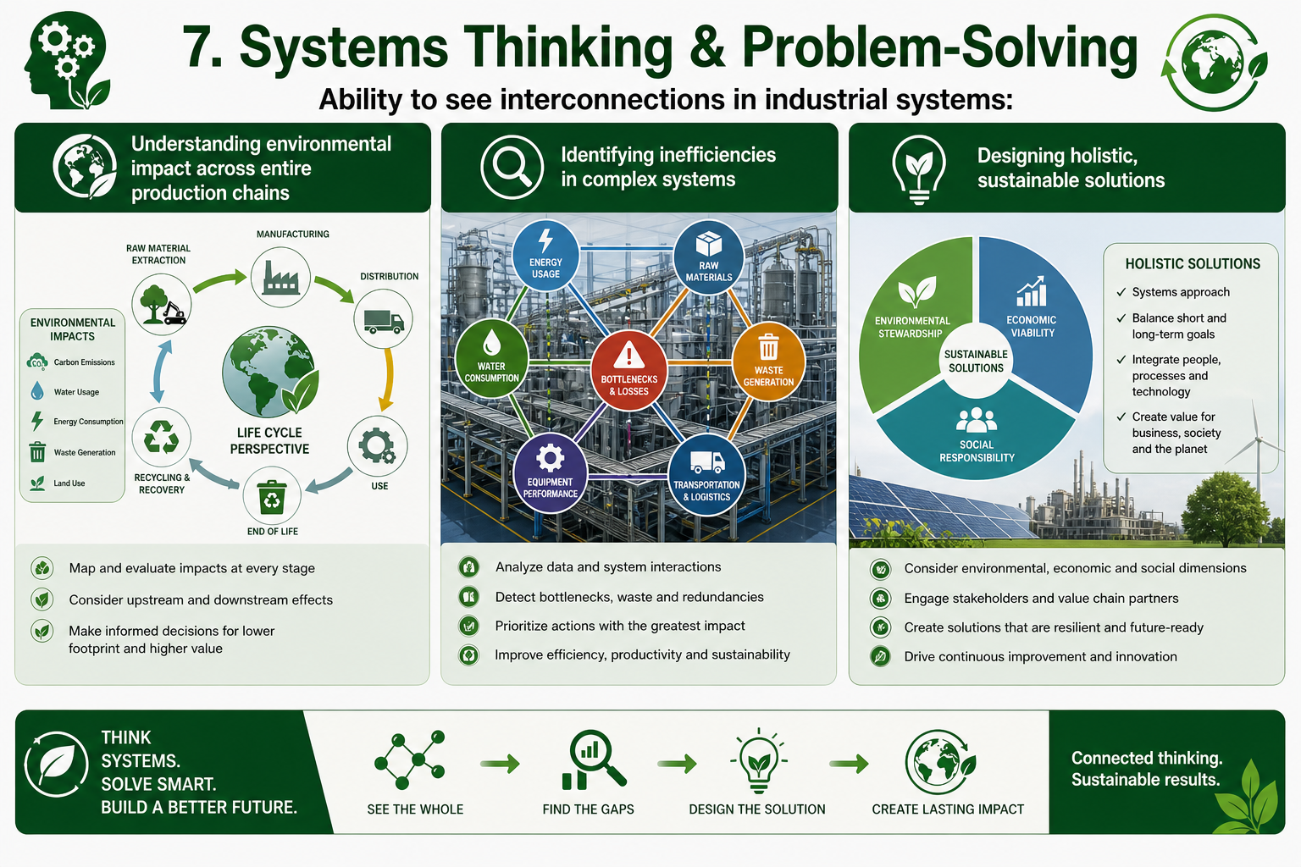
Key Dimensions of Building Green Skills for VET centres
Presentation Pillar 8

Slide 12
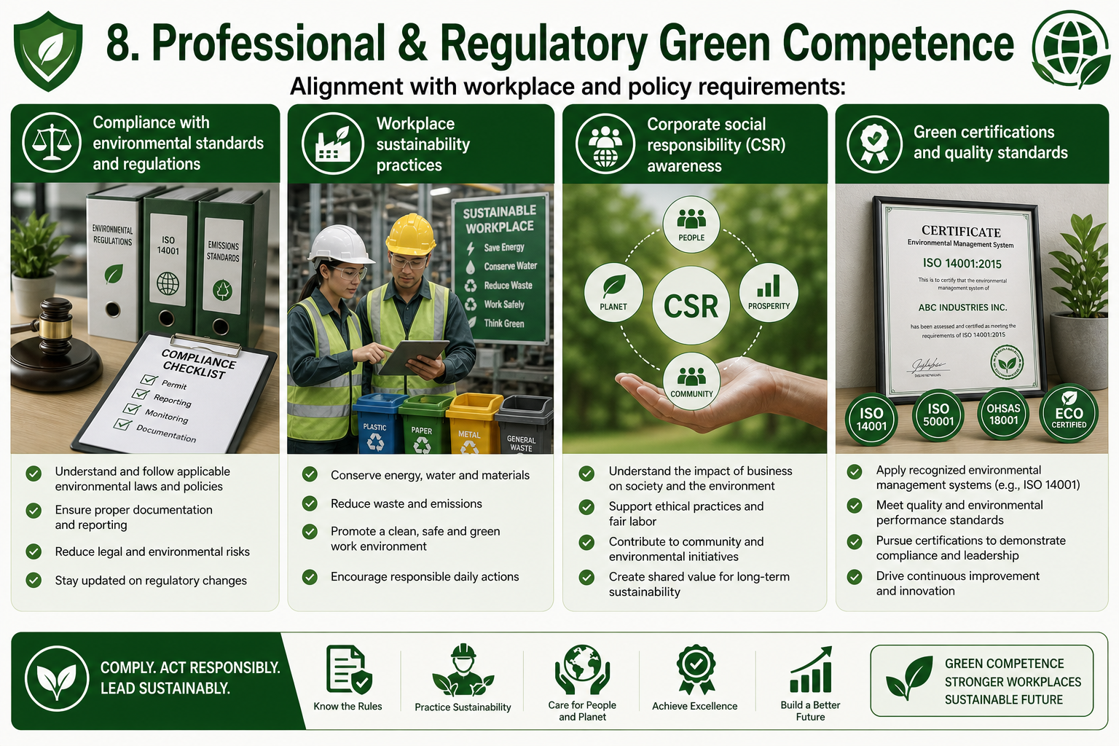
Key Dimensions of Building Green Skills for VET centres
Presentation Pillar 8

Slide 13
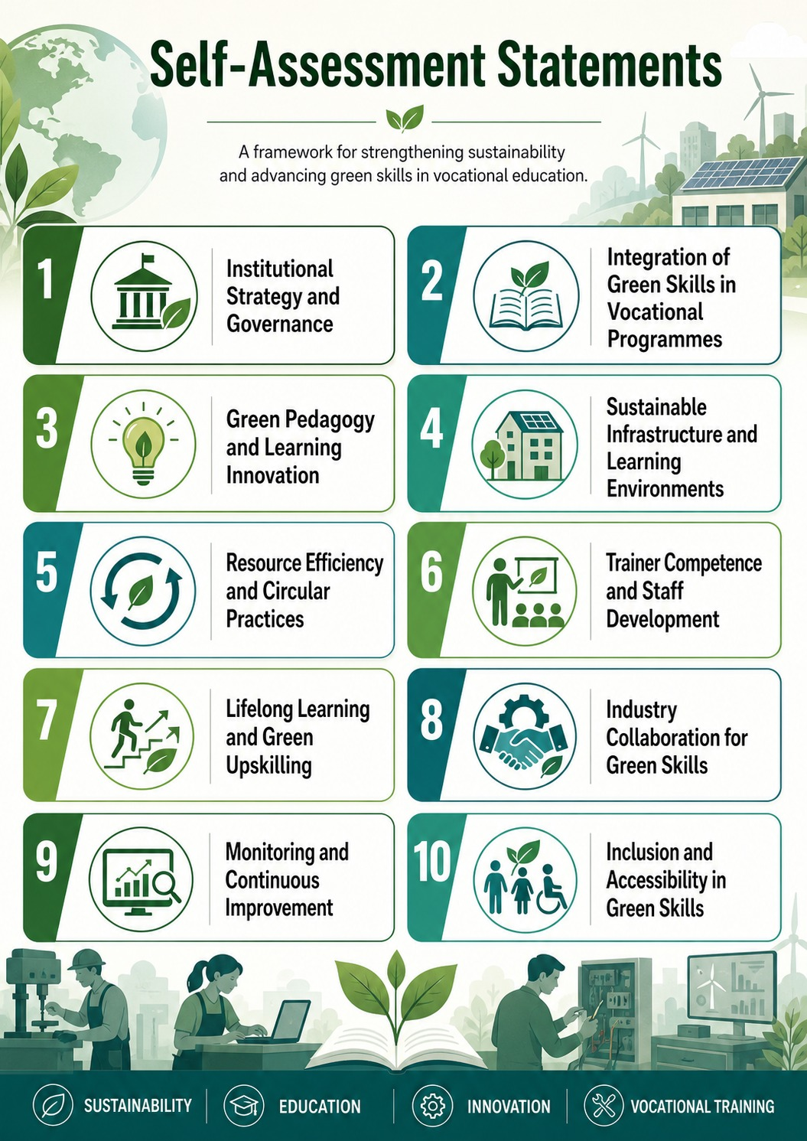
Presentation Pillar 8

Slide 14
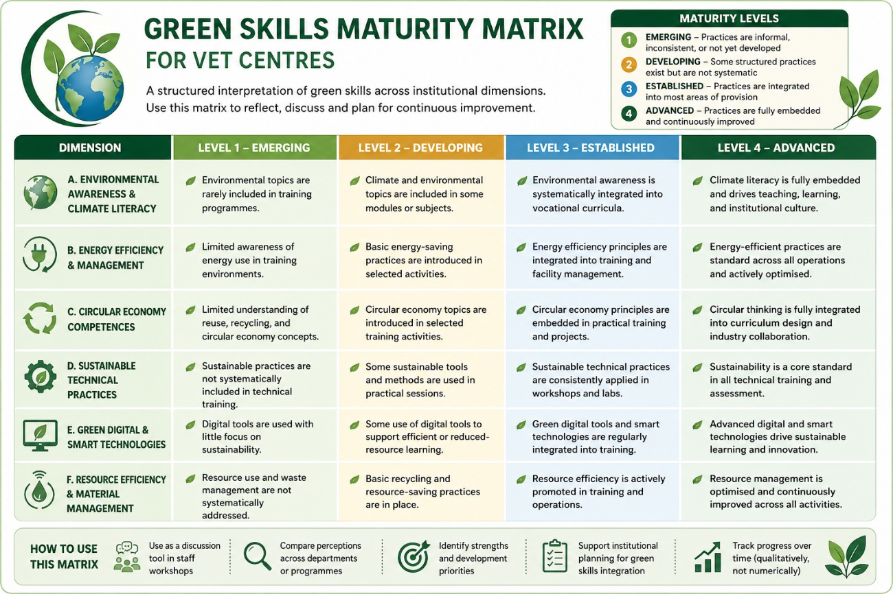
Presentation Pillar 8

Slide 15
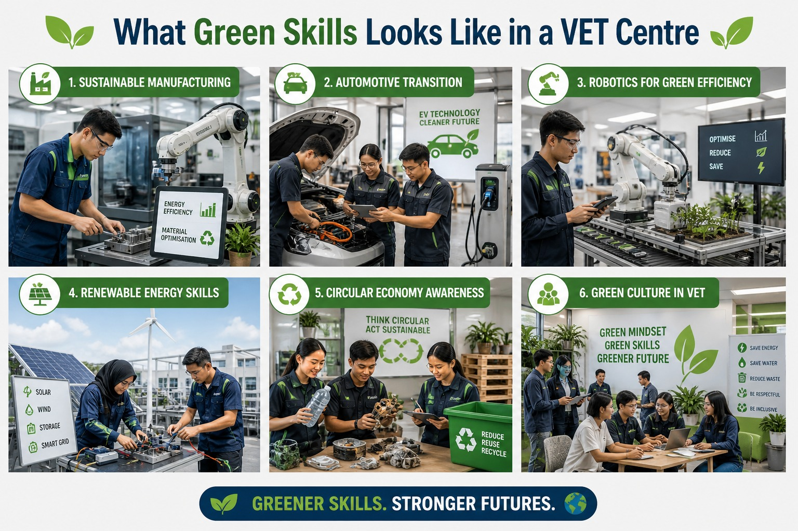
Presentation Pillar 8

Slide 16
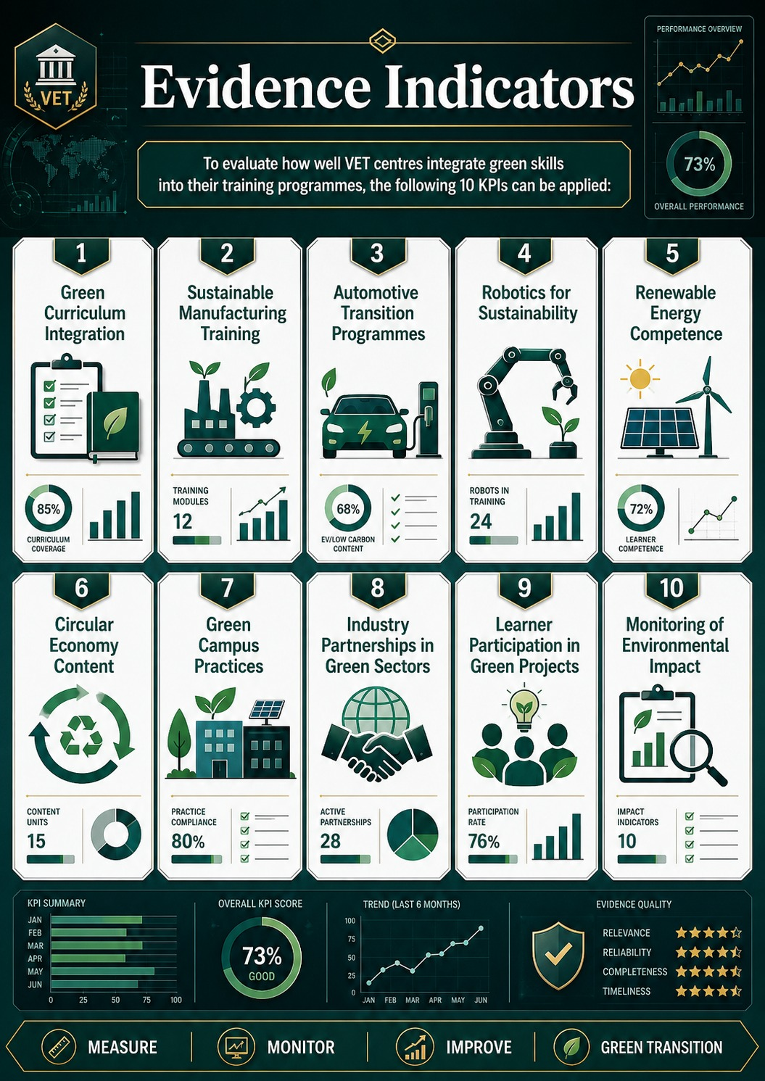
Presentation Pillar 8

Slide 17
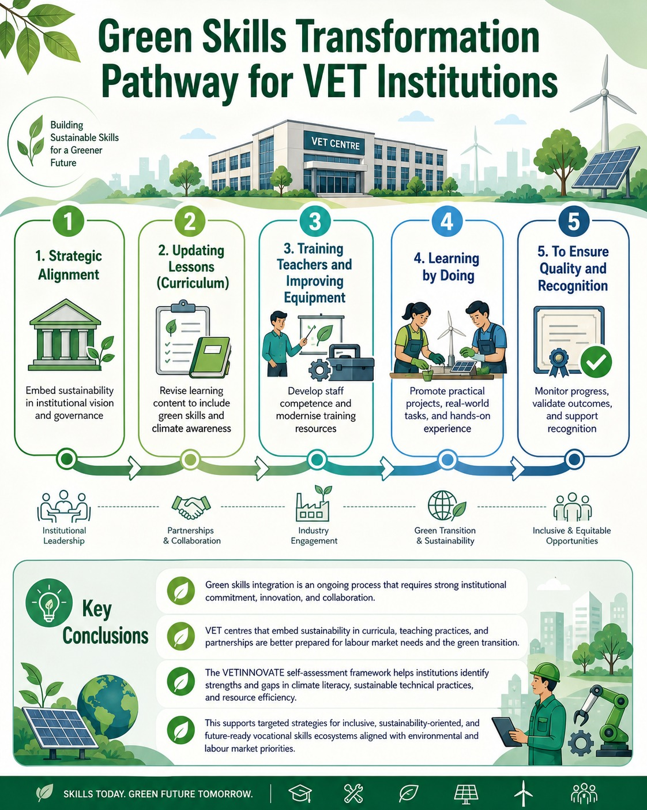
Presentation Pillar 8

Slide 18
Conclusions
Integrating green skills in VET is a continuous, long‑term effort that depends on strong institutional commitment, innovation and collaboration with industry and other stakeholders.
VET centres that embed sustainability across curricula and practices are better prepared to meet labour‑market demands driven by the green transition.
Using the VETINNOVATE self‑assessment framework helps institutions identify both strengths and gaps in areas such as climate literacy, sustainable technical practices and resource efficiency.
This assessment enables targeted strategies that strengthen inclusive, sustainability‑focused and future‑ready vocational skills ecosystems.
Aligning training with environmental priorities and labour‑market needs ensures relevance and resilience as the green economy evolves.
Presentation Pillar 8

Slide 19


  "VETInnovate: Transforming Skills, Transforming Regions"
Presentation Pillar 8

